Slide 1


Slide 2
Topics Covered
Client Server Architecture – with Real time Example
What is API?
Realtime API’s
API Testing
Why API Testing
URL, URI, Resource, HTTP Methods, Parameters, Headers and Status codes
Postman - API testing tool ( How to download and Install )
Hands-on GET,PUT, POST and DELETE Operations

Slide 3
Real time Example for Client- Server
Radisson blu
https://www.radissonhotels.com/sv-se/
Booking.com
https://www.booking.com/hotel/se.en-gb.html

Slide 4
Client – Server Architecture
HTTP Request
HTTP Request
Front End / User Interface
Angular, React, HTML, Css etc...
Application Layer/ Business Logic
Java, python etc..
API
XML, JSON
HTTP Response
HTTP Response
Data Base Layer

Slide 5
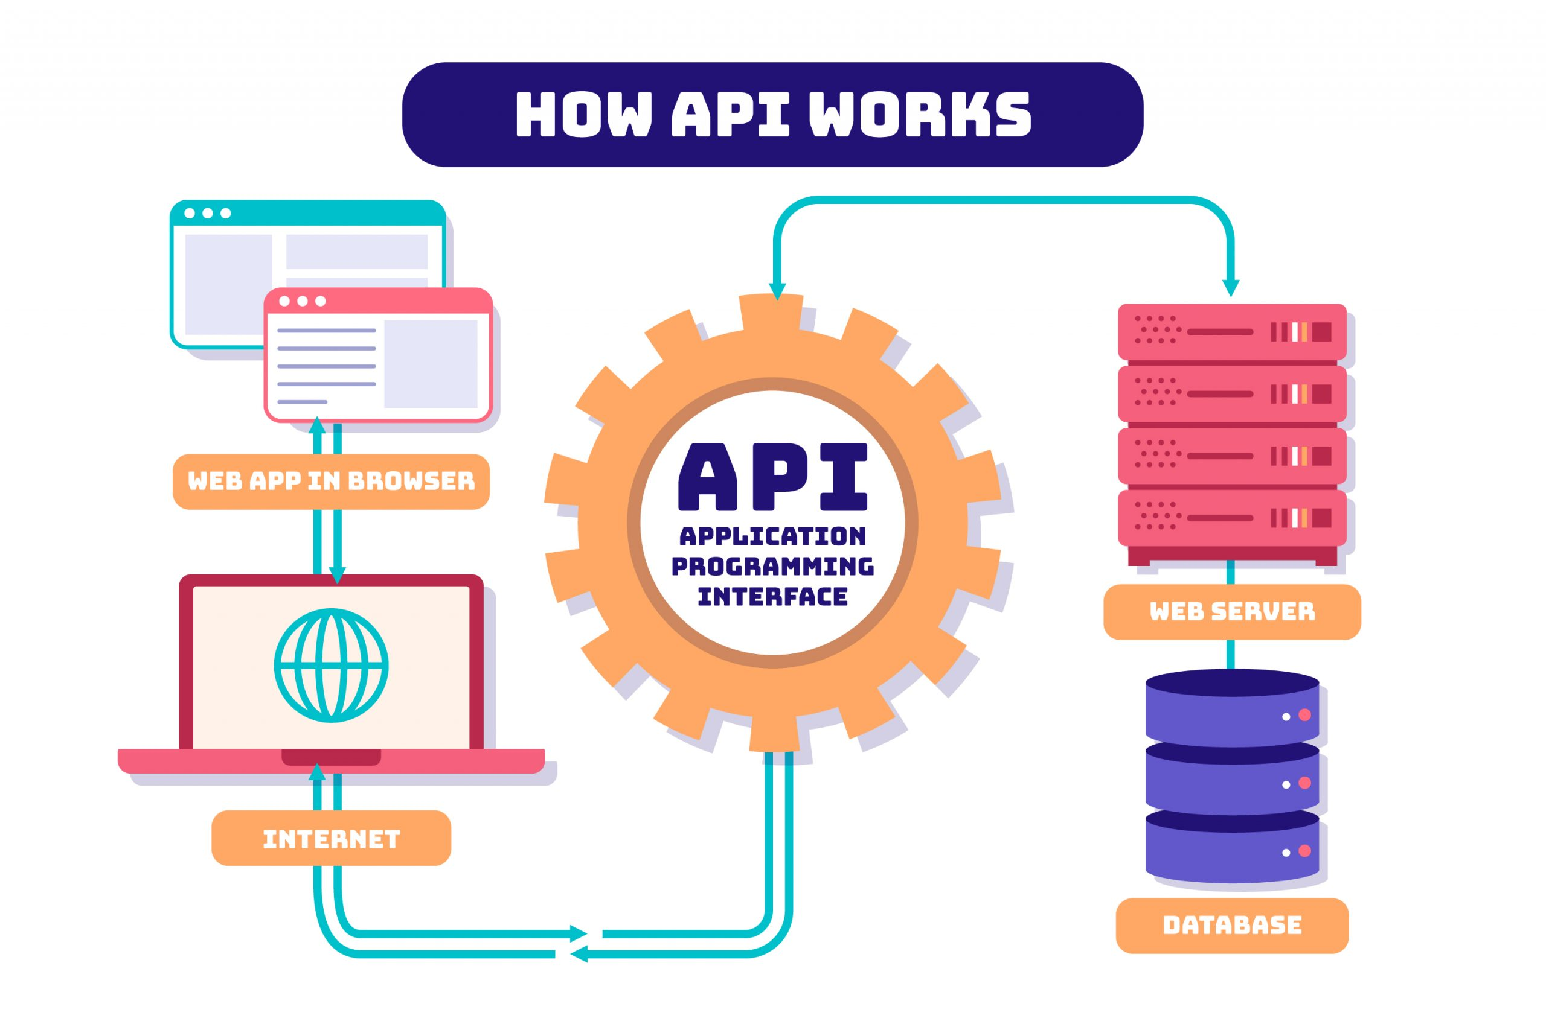
API – Application Programming Interface

Slide 6
Realtime API’s Realtime Example
Google API
https://console.cloud.google.com/apis/library
To practice
JIRA API
https://developer.atlassian.com/server/jira/platform/jira-rest-api-examples/
Radisson blu
https://www.radissonhotels.com/sv-se/
Booking.com
https://www.booking.com/hotel/se.en-gb.html

Slide 7
API Testing
API testing is a process of checking if an API (a set of rules that allows different software applications to communicate with each other) is working as it should by sending requests and checking the responses.
An application's core functionality is in the business logic layer, which communicates with other applications and users using an API.
API testing ensures the business logic, performance, and security of the application are working correctly, focusing on what the application does rather than its individual components or appearance.

Slide 8
Why API Testing
API testing is advantageous because it provides testers access to the application without a user interface, allowing them to run tests early on and detect defects before they impact the graphical user interface (GUI).
Testing the core functionality of the application via APIs is also time-effective and language-independent, leading to faster testing and reduced testing costs.
API tests can be run in parallel execution, leading to even faster results, unlike GUI tests which can be very time-consuming.

Slide 9
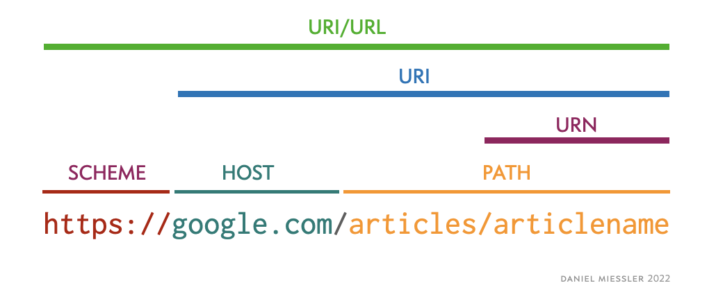
URL, URI

Slide 10
Resource
Resources represent API/Collection which can be accessed from the Server
Google.com/maps Google.com/search Google.com/images

Slide 11
Http Methods
HTTP methods which are commonly used to communicate with Rest API’s are
GET
The GET method is used to extract information from the given server using a given URI. While using GET request, it should only extract data and should have no other effect on the data. No Payload/Body required
POST
A POST request is used to send data to the server, for example, customer information, file upload, etc. using HTML forms.
PUT
DELETE
Replaces all current representations of the target resource with the uploaded content
Removes all current representations of the target resource given by a URI.

Slide 12
Parameters
Path Parameters:
Path parameters are variable parts of a URL path. They are typically used to point to a specific resource within a collection, such as a user identified by ID
https://www.google.com/Images/1123343 https://www.google.com/docs/1123343 https://amazon.com/orders/112
Query Parameters:
Query Parameter is used to sort/filter the resources.
Query Parameters are identified with “?”
https://amazon.com/orders?sort_by=2/20/2020
https://www.google.com/search?q=newyork&oq=newyork&aqs=chrome..69i57j0l7.2501j0j7&sourceid=chrome&ie=UTF-8

Slide 13
Headers/Cookies & End point
Headers represent the meta-data associated with the API request and response. In layman terms, we were sending Additional details to API to process our request.
Example : Authorization details
End Point Request URL can be constructed as below
Base URL/resource/(Query/Path)Parameters

Slide 14
Status Codes
Below are some of the commonly used status codes:
200 — OK
201 — Created
202 — Accepted
400 — Bad request
401 — Unauthorized
403 — Forbidden
404 — Not found: this is a famous one
405 — Method not allowed
500 — Internal Server Error
502 — Bad Gateway
503 — Service Unavailable
HTTP supports status codes are ranging from 100 to 500.
1XX — informational codes
2XX — successful codes 🙂 — we can call them happy codes.
3XX — redirection codes
4XX — client error codes
5XX — server error codes
1XX is uncommon to the users and mostly used to communicate in between systems.
Status Code Cheat Sheet

Slide 15
Postman – Download and Install
To Download:
https://www.postman.com/product/rest-client/#:~:text=Postman%20began%20as%20a%20REST,Postman%20API%20Platform%20for%20free.
Postman Testcase

Slide 16

Thank you.. Happy Testing..
Karthika Muthusamy

